Slide 1
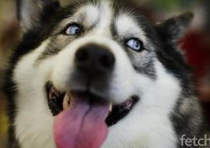
Texas husky rescue Volunteer meetinG
February 16, 2013
Ellie

Slide 2
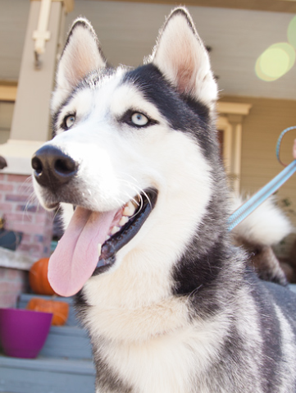
Meeting Agenda
2013 Objectives
Business Update
Volunteer Survey Results
New Organizational Structure
Upcoming Events
Open Forum
Pacino

Slide 3
Texas Husky Rescue, Inc.
MISSION STATEMENT
To rescue, rehabilitate and find qualified loving homes for neglected, abused and unwanted Huskies throughout Texas and beyond. To educate the public about responsible pet ownership and the special qualities of the Siberian Husky Breed.
2013 OBJECTIVES
Rescue approximately 175 huskies
Be an advocate for huskies and responsible pet ownership by educating the public about the unique characteristics of the breed and the importance of spaying/neutering their pets
Rescue and rehabilitate huskies with behavioral, medical, and physical ailments whenever logistically and financially feasible
Increase Texas Husky Rescue, Inc.'s exposure in the community by conducting and attending public events on a regular basis
Increase our involvement with and availability to our network of Fosters and Volunteers
Increase our network of Foster Homes

Slide 4
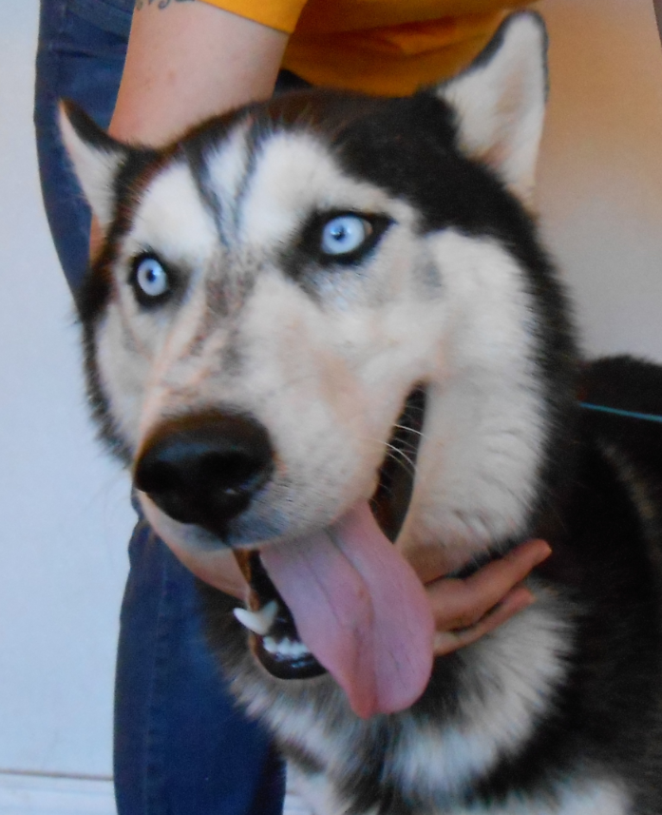
Making a Difference
Huskies Adopted
May 2009-Dec 2009 | 10
2010 | 129
2011 | 181
2012 | 160
Huskies Rescued
May 2009-Dec 2009 | 31
2010 | 147
2011 | 170
2012 | 156
Charlie

Slide 5
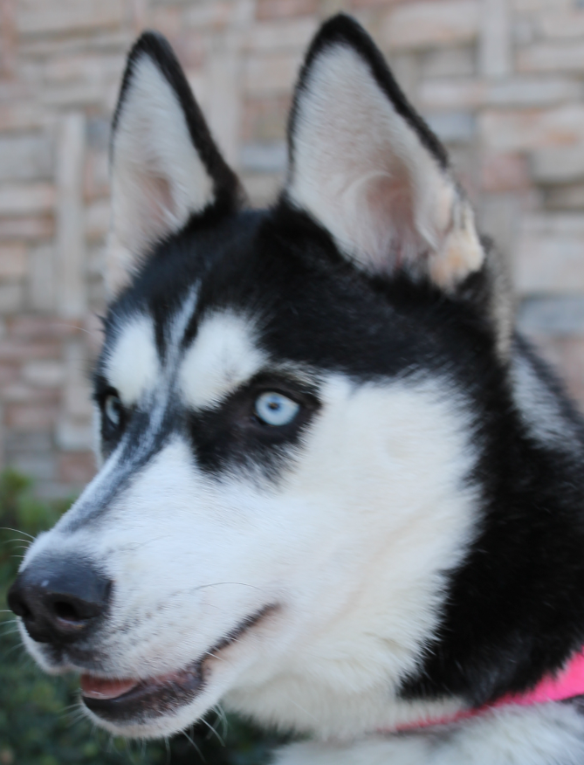
Volunteer Survey Results
Top 5 Responses
Would like to see Meet & Greet locations other than Grapevine PETCO store location
Not sure who does what on the Board of Directors
Improved communication from the organization and the format in which it’s delivered
More volunteer opportunities with added responsibility
Volunteer focused events
Asha

Slide 6
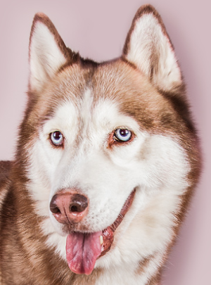
Volunteer Survey Results
Meet & Greet locations other than Grapevine PETCO store location
2nd Saturday at Grapevine Petco to continue
This event is so successful that we do not want to discontinue this regular event or the frequency of it
Events team researching new locations for our 2013 events schedule
Several factors determine a good event location:
Size and set up of the store
Physical location
PetSmart requires dogs to be crated
Suggestions are welcome!!!
Ultimate goal is to add an additional Meet & Greet
per month at an alternate location
Rachel

Slide 7
Volunteer Survey Results
Not sure who does what on the Board of Directors
New BOD structure to help alleviate confusion
Board of Directors Contact list
New emails have been added for simplification
New team members added to support the growth of the organization
Improved communication from the organization and the format in which it’s delivered
Volunteer Facebook page is not the preferred method of communication
Going forward all key messages will be communicated via email in addition to the Volunteers Facebook page
Quarterly volunteer newsletter in the planning stage
Volunteer Facebook Page
Created to provide our Volunteers and Fosters a forum for support, advice and the opportunity to share their passion for the work we all do.
Based on survey feedback, we request that any lost/found/shelter dog notices be sent to intake@texashuskyrescue.org and not posted on the Volunteer page.
If you are interested in helping the Intake team with tracking lost/found/shelter dogs, please contact Cate at cate@texashuskyrescue.org

Slide 8
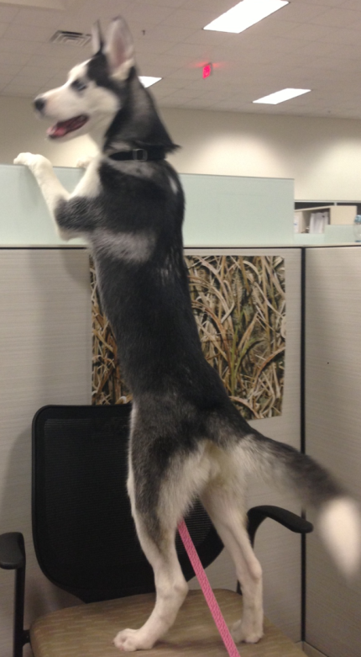
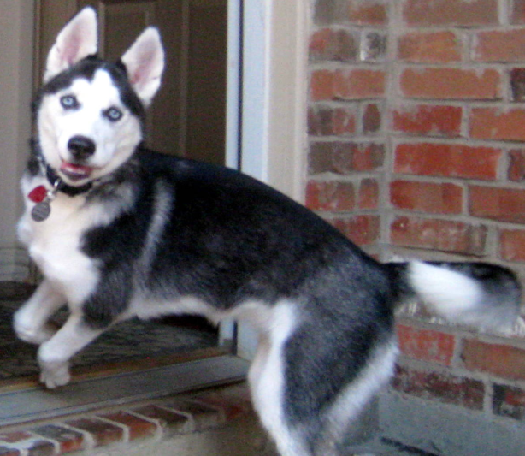
Volunteer Survey Results
More volunteer opportunities with added responsibility
The addition of many key Coordinator Roles have been added
This is still a work in progress as we work through our plans!
Volunteer focused events
Events Coordinator added that will plan quarterly get together events
Fundraising events (with and without dogs)
Dog park outings for volunteers
Meekah

Slide 9
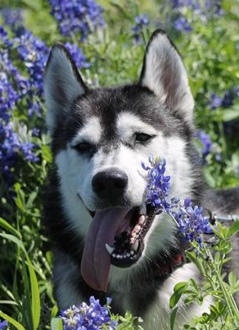
NEW Organizational structure
Lilly

Slide 10
Leisha Adams President & Co-Founder Marketing/PR Marketing & PR Coordinator OPEN
Cate Connors Treasurer, VP of Intake, Fosters & Co-Founder | Cecily Miller VP of Fosters, Adoptions & Co-Founder | Courtney Cochrane VP of Animal Wellness & Communications | Patty Hasselman VP of Events & Volunteers | Mary Bolton VP of Fundraising & Graphic Design | James Bolton VP of Technology & Partner Outreach
Intake Coordinator: Jacqueline Johnsrud Claudia Marquez Megan Toofan Elizabeth Hiatt Rachel Battaglia Foster Mentor: Rachel Battaglia Scott Todd Foster Recruitment Coordinator: OPEN Boarding Coordinator: OPEN | Adoption Coordinators: Sandy Kirkpatrick Tammy Gromatzky Pre-Screening Assistant: Elise Craig Database Assistant: OPEN Home Check Coordinator: Jarret Lonsdale OPEN Adoption Mentor: Julie Welch OPEN Adoption Packet Assistant: OPEN | Medical Coordinator: Elise Craig Dog Database Coordinator: Wendy Todd Communication Coordinator: Pam Chamberlain Profile & Petfinder Coordinator: Susan Mynyk | Volunteer Coordinator: Leslie Adcock Events Coordinator: Natalie Blanco Volunteer Recruitment Coordinator: Kelli Graham | Social Media Coordinator: Tess Smith Graphic Design Assistant: Christine Simpson Fundraising Coordinator: OPEN | Web Assistant: Nancy Dysinger OPEN Google Apps Administrator: Jonathan Matthews Partner Outreach Assistant: OPEN

Slide 11
Leisha Adams President & Co-Founder Marketing & PR
Marketing & PR Coordinator Help drive our marketing and PR campaigns OPEN

Slide 12
Cate Connors Treasurer, VP of Intake, Fosters & Co-Founder
Intake Coordinators Communicate with shelters to learn more about the huskies in need of saving and coordinate efforts around pulling them Jacqueline Johnsrud Claudia Marquez Rachel Battaglia Megan Toofan Elizabeth Hiatt Foster Mentors Provide mentorship and guidance for TXHR Foster Network Rachel Battaglia Scott Todd Foster Recruitment Coordinator Network and actively recruit new Foster homes for the program OPEN Boarding Coordinator The main contact for boarding regarding the dogs and temporary boarding for fosters. Includes keeping track of their location in the database, that they have supplies, etc. OPEN

Slide 13
Cecily Miller VP of Fosters, Adoptions & Co-Founder
Adoption Coordinators Assist with training Adoption Counselors, monitor applications and provide leadership throughout adoption process Sandy Kirkpatrick Tammy Gromatzky Pre-Screening Assistant Conducts vet checks and landlord/apartment checks before screening begins Elise Craig Adoption Counselors: Conducts applicant interviews and determines if an applicant is a good fit May Finch, Vanessa Deem, Faith Phillips, Rachel Battaglia, Barbara Boucher, Tess Smith Adoption Packet Assistant Email adoption packets after an adoption has been finalized OPEN Database Assistant Responsible for ensuring contracts are in the database and keeping the ‘People’ side up to date OPEN Home Check Coordinator Work with Adoption Counselors to ensure we have fence photos or home check prior to adoption Jarret Lonsdale OPEN Adoption Mentor Provide support and mentorship to Adopters Julie Welch OPEN

Slide 14
Courtney Cochrane VP of Animal Wellness & Communications
Medical Coordinator Manages all medical transport, appointments and ensuring dogs are being properly vaccinated upon entry to our program Elise Craig Dog Database Coordinator Enters all new dogs in to the database and updates all vetting paperwork so we have a complete and comprehensive file for every dog in the program Wendy Todd Profile Coordinator Writes all the profiles for online use Updates photos on Petfinder and Rescuegroups.org Susan Mynyk Communication Coordinator Develop, implement and grow our newsletter communications Pam Chamberlain

Slide 15
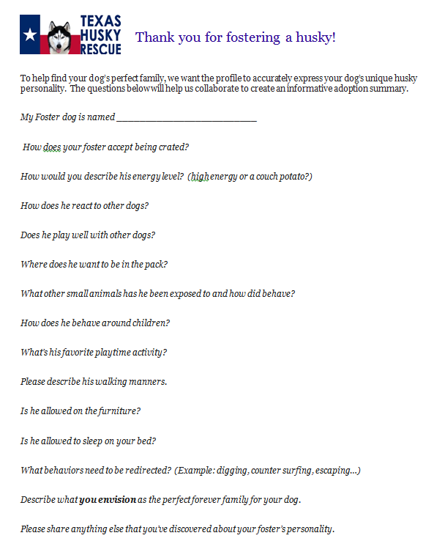
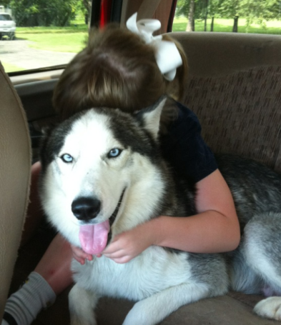
Foster Dog Profiles
Give your Foster Dog
the best chance to find a new home!
Susan will email you directly periodically for updates on your foster dog
Please provide the best information possible so the bio’s online are accurate and compelling!

Slide 16
Patty Hasselman VP of Events & Volunteers
Volunteer Coordinator Oversee current volunteer retention, recognition and volunteer oriented events Leslie Adcock Events Coordinator Manages current M&G’s including sending communication emails and researching new locations Natalie Blanco Volunteer Recruiter Grow new volunteer recruitment initiatives and integration of new volunteers to the group Kelli Graham

Slide 17
Mary Bolton VP of Fundraising & Graphic Design
Social Media Coordinator Moderate the TXHR Facebook page, communicating our mission to the public Tess Smith Graphic Design Assistant Enhances our brand and our image through the use of consistent and eye-catching graphics and photos to help our various communications draw more attention Christine Simpson Fundraising Coordinator Help research fundraising opportunities such as grants, small scale events, rewards programs, and item sales. Assist with coordination of these programs through applications, calling for donations, or helping with event organization OPEN

Slide 18
James Bolton VP of Technology & Partner Outreach
Web Assistant Updates the texashuskyrescue.org website and develop new functionality Nancy Dysinger Google Apps Administrator Manages the group’s email and related services. Provide help using email, drive/docs, calendar, etc. Jonathan Matthews Partner Outreach Assistant Contact new partners for TXHR to work with. The partners are vets, boarding, trainers, groomers, etc. who can provide TXHR with services at reduced cost, extend our reach, provide fundraisers, and/or increase our visibility. OPEN

Slide 19
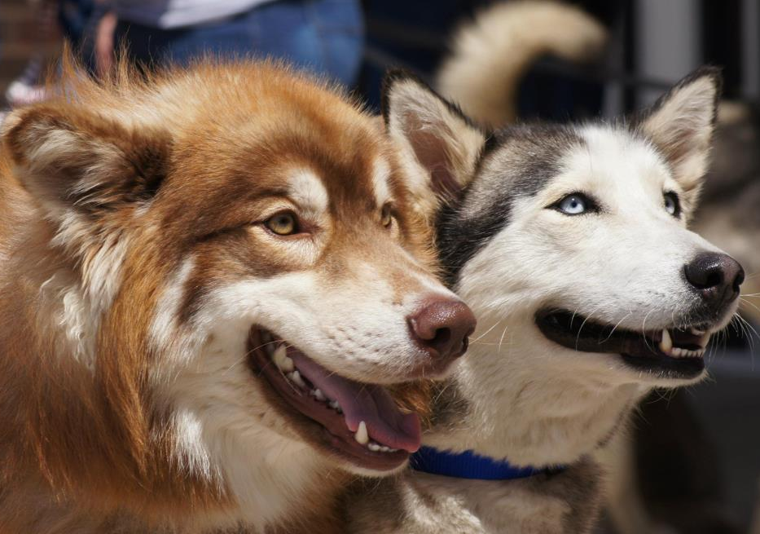
Upcoming Events
Valentine & Benton

Slide 20
Upcoming Events
Dirty Dawgz Fundraiser
Planning a 2nd event in April or May
Will have 3 total this year
Quarterly Volunteer Oriented Events
TXHR sponsored events
May incorporate fundraising and/or organization promotion but are intended to be an opportunity for volunteers to get to know each other and have fun

Slide 21
2013 Golf Tournament
Location and date to be finalized by end of February
Golf Tournament Committee
Golf Tournament Chairperson: Patty Hasselman
Raffle & Silent Auction Coordinator: Leslie Adcock
Sponsorship Coordinator: OPEN
Requires meeting once a month; possibly more as tournament gets closer
Need help recruiting Sponsors, Golfers & Auction and Raffle items

Slide 22
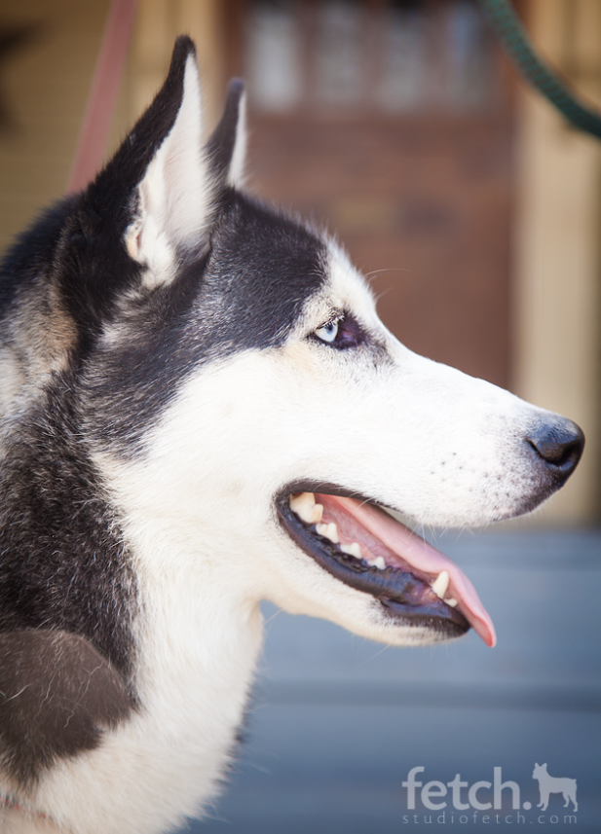
Open Positions
Foster Recruitment Coordinator
Boarding Coordinator
Adoption Mentor
Home Check Coordinator
Adoption Packet Assistant
Fundraising Coordinator
Partner Outreach Assistant
Web Assistant
Pacino

Slide 23
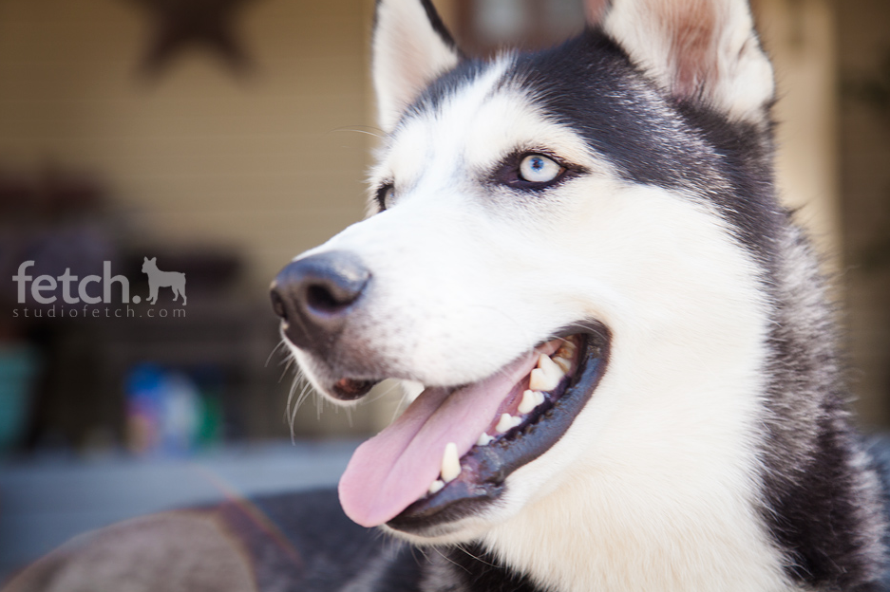
THANK YOU for making TXHR a success!!!
Pacino

Slide 24
2013 TXHR Contact List
Topic | Primary Contact Email | Board Sponsor | Contact Information
Emergency Contact | board@texashuskyrescue.org | Leisha Adams | leisha@texashuskyrescue.org / 972-859-9254
Medical | medical@texashusky rescue.org | Courtney Cochrane | courtney@texashuskyrescue.org / 972-989-2527
Intake | intake@texashuskyrescue.org | Cate Connors | cate@texashuskyrescue.org / 314-518-9725
Fosters | foster@texashuskyrescue.org | Cate Connors | cate@texashuskyrescue.org / 314-518-9725
Adoptions | adopt@texashuskyrescue.org | Cecily Miller | cecily@texashuskyrescue.org / 214-364-8191
Applications | applications@texashuskyrescue.org | Cecily Miller | cecily@texashuskyrescue.org / 214-364-8191
Events | events@texashuskyrescue.org | Patty Hasselman | patty@texashuskyrescue.org / 562-234-6208
Volunteering | volunteerhelp@texashuskyrescue.org | Patty Hasselman | patty@texashuskyrescue.org / 562-234-6208
Fundraising | fundraising@texashuskyrescue.org | Mary Bolton | mary@texashuskyescue.org / 214-707-6341
Outreach | outreach@texashuskyrescue.org | James Bolton | james@texashuskyrescue.org / 214-275-9503
General Questions | contact@texashuskyrescue.org | Entire Board of Directors | board@texashuskyrescue.org
Name, Title, email and phone # of all board members here

